Slide 1
Technology Changes History
Lesson 2: Technology Through Time

Slide 2
Big Idea
Technology is in a constant state of change as humans continue to improve and innovate “old” technologies for “new” applications.

Slide 3
Essential Questions
When did technology begin?
What were the first inventions?
How did technology impact humans?

Slide 4
Technology is increasing at an exponential rate.
During the information age (the last 50 years), more inventions have been developed than throughout the entire course of history.

Slide 5
Key Developments
Key developments have helped transform society and shape our culture such as:
Wheel
Printing Press
Mass Production
Interchangeable Parts
Computer
Integrated Circuit
These developments also continue to offer us new opportunities for innovation

Slide 6
History
History defined:
A chronological record of significant events, often including an explanation of their causes
Major Time Periods:
Paleolithic Age o Industrial Age
Mesolithic Age o Information Age
Neolithic Age
Bronze Age
Iron Age
Middle Ages
Renaissance/Enlightenment
Notes:
Stone Age
Bronze Age
Iron Age
Middle Ages
Renaissance
Industrial Age
Information Age

Slide 7
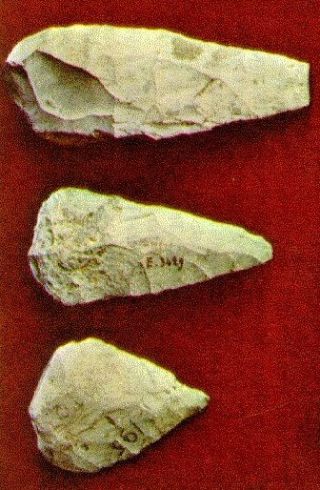
Paleolithic Age
Archaeological period characterized by the earliest known stone tool manufacture.
Artifacts: stone axes, bone needles, hearth sites
Impacts on history: Improved diet and enhanced security enabled early humans to increase their numbers.
Stone Axes
(www.personal.psu.edu/users/w/x/wxk116/axe)

Slide 8
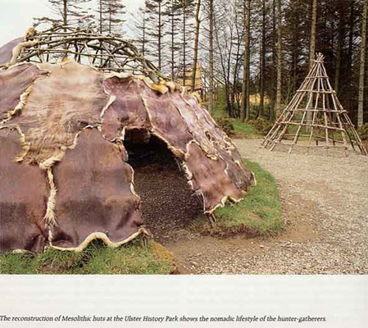
Mesolithic Age-10,000 BC-4000 BC
The period between the Paleolithic and the Neolithic, associated with the rise to dominance of microlithics (very small geometric form tools commonly used in composite tools)
Artifacts: leatherwork, basketry, fishing tackle, stone axes and wooden objects, canoes and bows, domesticating animals, stone circles, henges
Impact on history: The gradual domestication of plants and animals led to the beginnings of settled communities.
Housing
(http://www.usm.maine.edu/~mcgrath/ireland_images/pages/mesolithic_huts.htm)

Slide 9
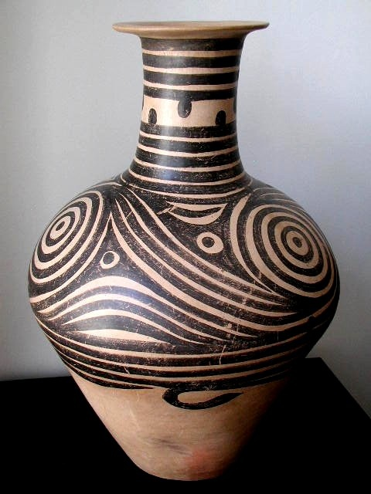
Neolithic Age-4000 BC-2300 BC
The period is characterized by the development of agriculture and an increasing emphasis on year-round settlements.
Artifacts: pottery, polished stone tools, spinning and weaving tools, wooden plows, sickles
Impact on history: Dependable year-round food supply enables division of labor and specialization that spurs invention and innovation.
Pottery
(http://www.albertomanuelcheung.com/Neolithic%20Machiayao%20Jar.htm)

Slide 10
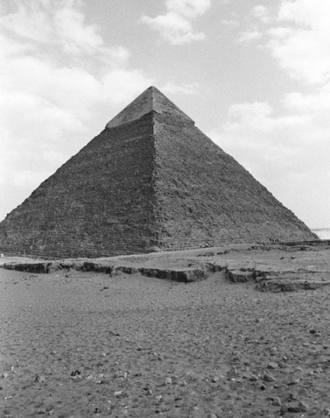
Engineers of Early Civilizations
Mesopotamian engineers used clay tablets to document irrigation systems, city plans, etc.
Babylonian engineers used mathematical concepts such as algebra for land excavation calculations and built asphalt-covered roadways.
Egyptian engineers built the pyramids and complex irrigation systems.
Pyramid
(http://www.point101.com/product.php?xProd=562)

Slide 11
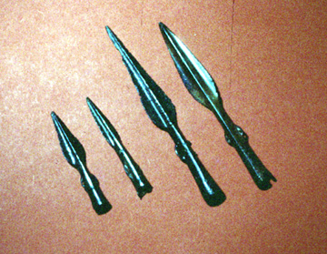
Bronze Age-2300 BC-700 BC
Includes earliest civilizations and the development of metallurgy, mainly the combining of copper and tin to make bronze
Artifacts: bronze jewelry, tools, weapons
Impact on history: Stone tools were gradually replaced by metal ones that enabled humans to alter their environment at a great rate.
Weapons
www.chichester.gov.uk/museum/tl2250.htm)

Slide 12
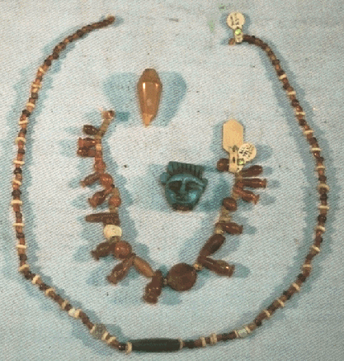
Iron Age 700 BC-450 AD
Iron used as the main metal
Artifacts: iron chisels, ornamental jewelry, swords, axes, spearheads
Impact on history: Military dominance for uses of iron weapons and the use of iron-bladed plows enabled humans to increase food production.
Jewelry
(www.bu.edu/anep/Ir.html)

Slide 13
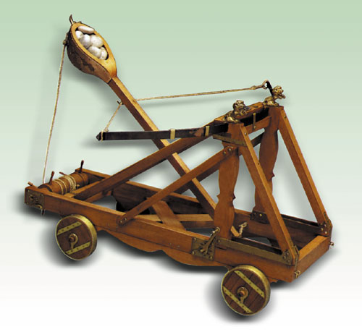
Greek and Roman Engineers
Greek engineers created the crossbow and catapult to conquer territories.
Roman engineers created aqueduct systems, sanitary systems, and an extensive road system. In addition, the first steam engine was created during the Roman Empire.
Catapult
(http://www.cannon-mania.com/kits-catapults.htm)

Slide 14
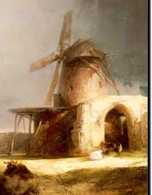
Middle Ages-450-1400 AD
Period of time between the fall of Rome and the Renaissance
Artifacts: wheeled plow, horseshoes, waterwheels, windmill, cast iron, cannons, ocean-going ships
Impact on history: rise of money and capitalism, rise and fall of feudalism, beginning of urbanization and industrialization
Windmills
(http://www.uea.ac.uk/his/ceas/region.shtml)

Slide 15
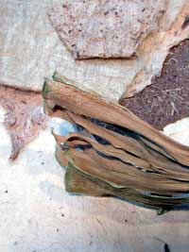
Middle Age Engineers
Arab society developing paper and chemistry applications
Chinese society developing clocks, gunpowder, and astronomical instruments
The word engineer began to appear. Its root lies in the Latin word ingeniare, “to design or devise.”
Paper
(http://www.mallegni.com/phil.html)

Slide 16
Renaissance/Enlightenment-1400- 1750 AD
Humanistic revival of classical influence
Artifacts: telescope, microscope, thermometer, clocks, compass, barometer
Impact on history: Instrumentation allowed scientists to observe and test natural phenomena.
Galileo’s Telescope
(http://www.yesnet.yk.ca/schools/projects/renaissance/galileo.html)

Slide 17
Leonardo da Vinci
Leonardo was born in Italy in 1452. Beginning his career as an artist, painting and sculpting, he was soon put to work designing weapons, buildings, and machinery. See the interactive site below for some of his discoveries.
Exploring Leonardo:
http://www.mos.org/sln/Leonardo/

Slide 18
Galileo
Galileo was born in Italy in 1564. Throughout his career, Galileo discovered many physics properties. See the interactive sites below for some of his discoveries.
Experiments:
http://www.pbs.org/wgbh/nova/galileo/experiments.html
Link to video from NOVA program on Galileo:
http://www.pbs.org/wgbh/nova/galileo/science.html

Slide 19
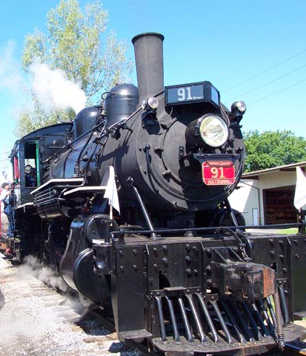
Industrial Age -1750-1950 AD
First use of complex machinery, and factories. Social changes from agricultural societies.
Artifacts: steam engine, electricity, automobile, airplane, radio, television, telephone, rocket
Impact on history: gave rise to urban centers requiring municipal services, population expansion, and improvement in living standards
Steam Engine
(http://www.mhrailroad.com/mhrrphoto2.htm)

Slide 20
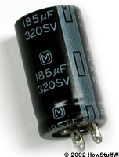
Industrial Age Engineers
James Watts refines the steam engine for practical use.
Alessandro Volta discovers the principles for a battery.
Pieter van Musschenbroek creates the forerunner to the capacitor.
Henry Ford creates the concept of the assembly line.
Capacitor
(http://electronics.howstuffworks.com/camera-flash3.htm)

Slide 21
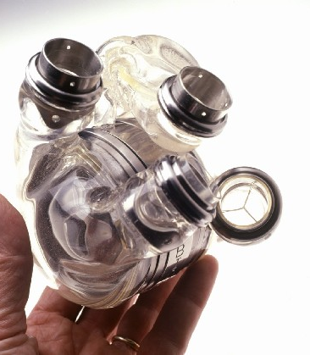
Information Age-1950AD-Present
Central to society is the gathering, manipulation, classification, storage, and retrieval of information.
Artifacts: transistor, IC, computer, satellite, digital photography, artificial heart, nuclear power plant, space shuttle
Impact on history: decentralization of decision making and empowering more people
Artificial Heart
(http://science.howstuffworks.com/artificial-heart.htm)

